Slide 1

MINI ELECTION SYSTEM
Section Name :B-10
Project Team Members:-
1. Y.Bharath Kumar-9922005075-20228688
2.M.Divakar-99220041736-20228693
3.H.Dheeraj Kishore-99220040269-20223820
4.T.Akash Reddy-99220040209-20220575
5.K.Maharshi-9922008383-20226264
Guided by
Mrs. K.INDHUMATHI,MCA,(Ph.D)
ASSISTANT PROFESSOR OF CSE,KARE.

Slide 2
INTRODUCTION
In this program we can cast our vote to the representative.
With this program we can able to conduct mini elections to elections to elect our representative in schools and colleges etc.
Using this we can even know the situation of the election or leading candidate during the election process itself.
Online voting system is better than the offline system because its saves both time and money.

Slide 3
OBJECTIVES OF THE PROJECT
Keeps a record of every voting process.
Allows us to setup a flexible and trustworthy voting system.
Applicable for large as well as small group of people.
eg: A batch, A class

Slide 4
OPERATIONS
In the Election voting System, the following operations are performed
Age eligibility to cast vote.
Cast the vote.
Find vote count.
Find leading candidate.

Slide 5
FEATURES
It will be easy to use.
We can elect the person who was nominated in advance.
Only the persons above 18 years are eligible for voting.
Voters may have list of candidates through this system.

Slide 6
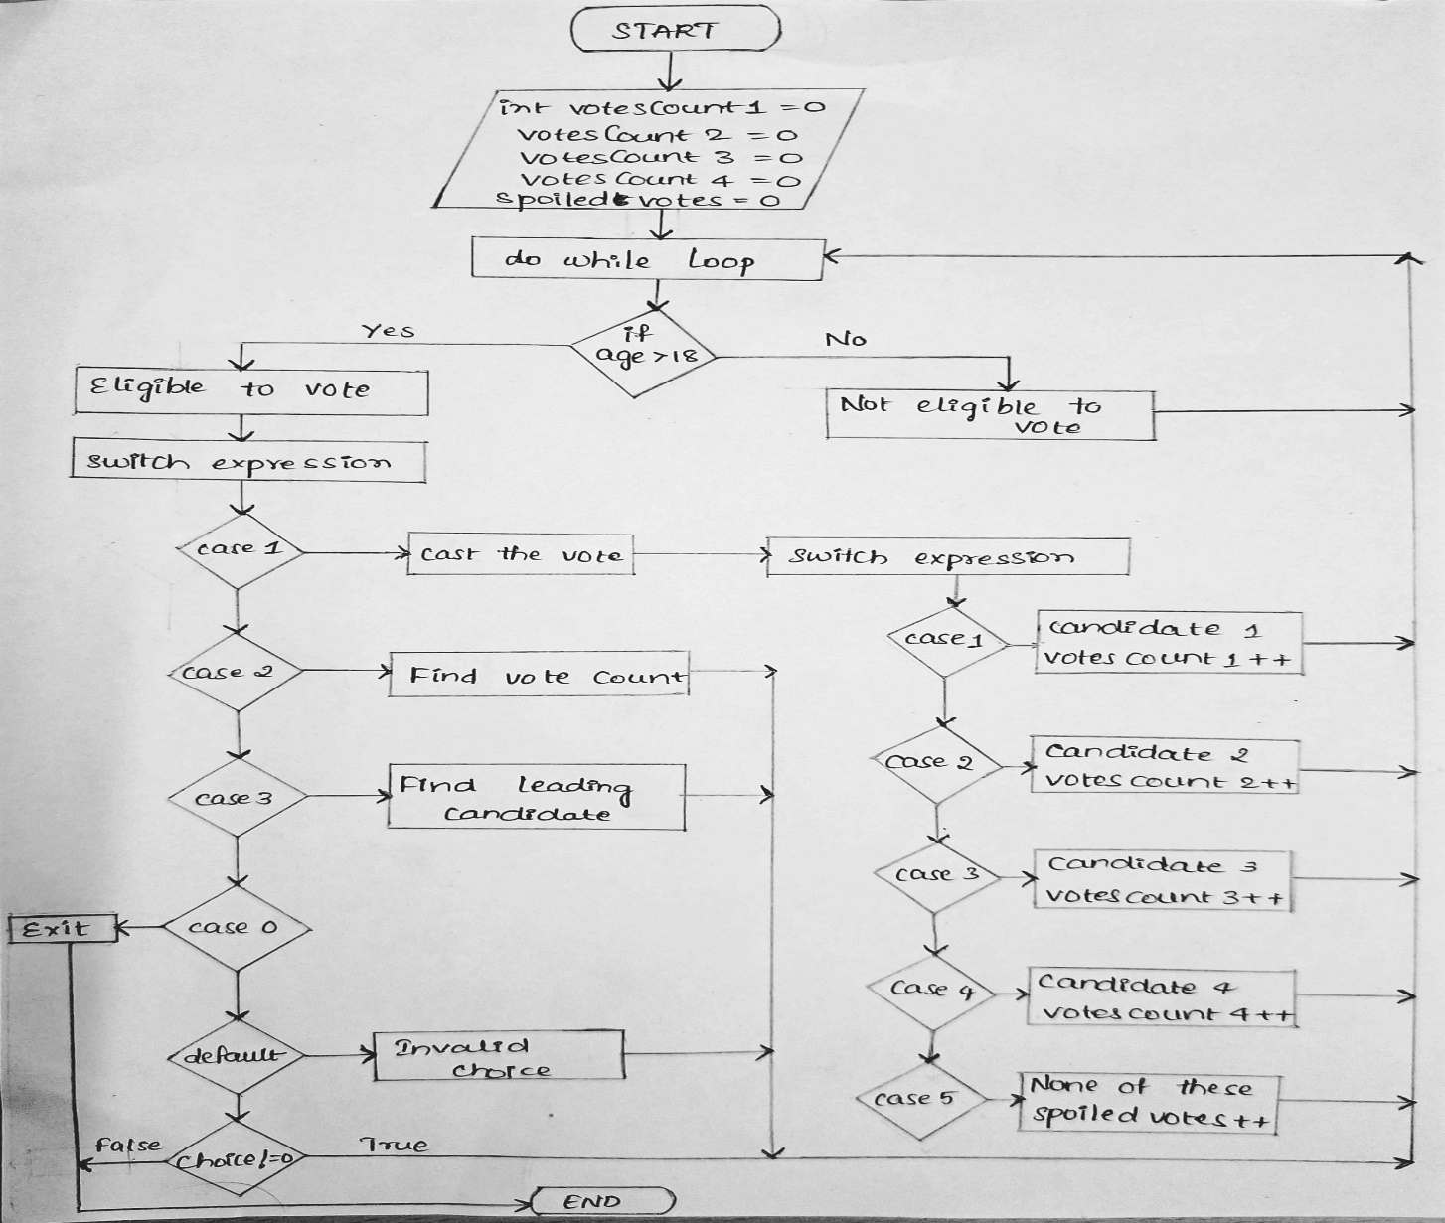
FLOW CHART

Slide 7
KEYS
#include<stdio.h>
#include<conio.h>
TYPES OF STRUCTERS
#define;
Int votes;
Int choice;
Int i;
Getchar();
Clrscr();

Slide 8
PROGRAMMING FUNCTION
ELSE IF condition.
SWITCH condition.
DO WHILE function.
IF condition.

Slide 9


Slide 10
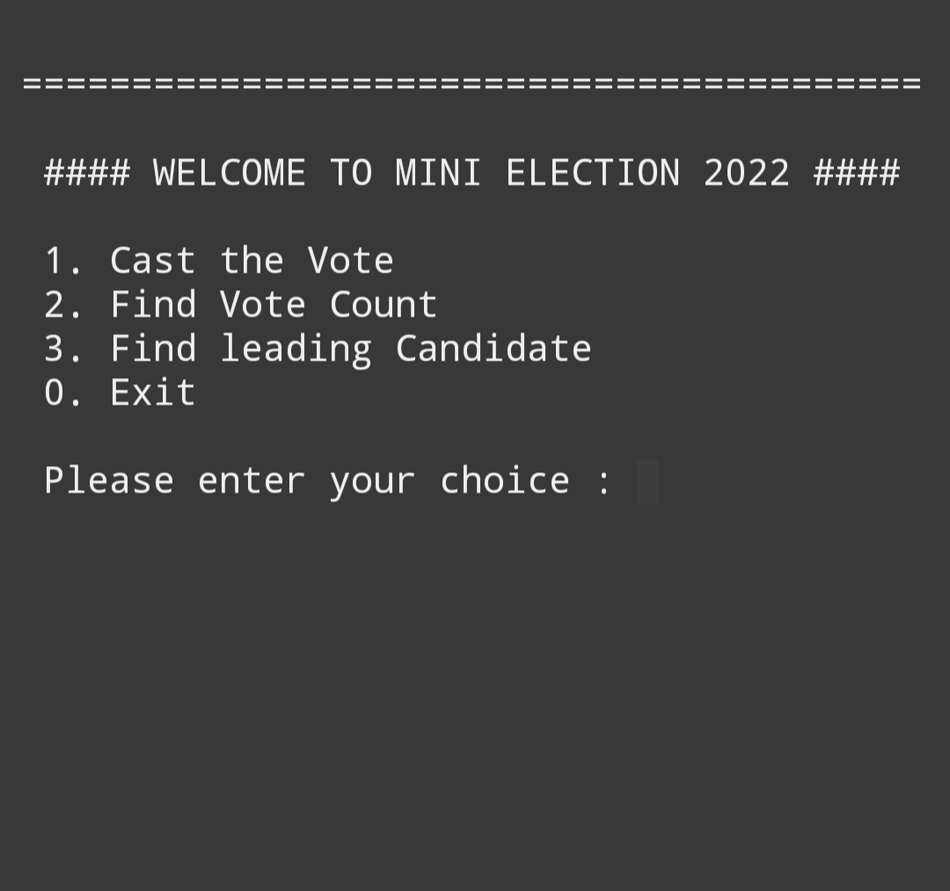

Slide 11
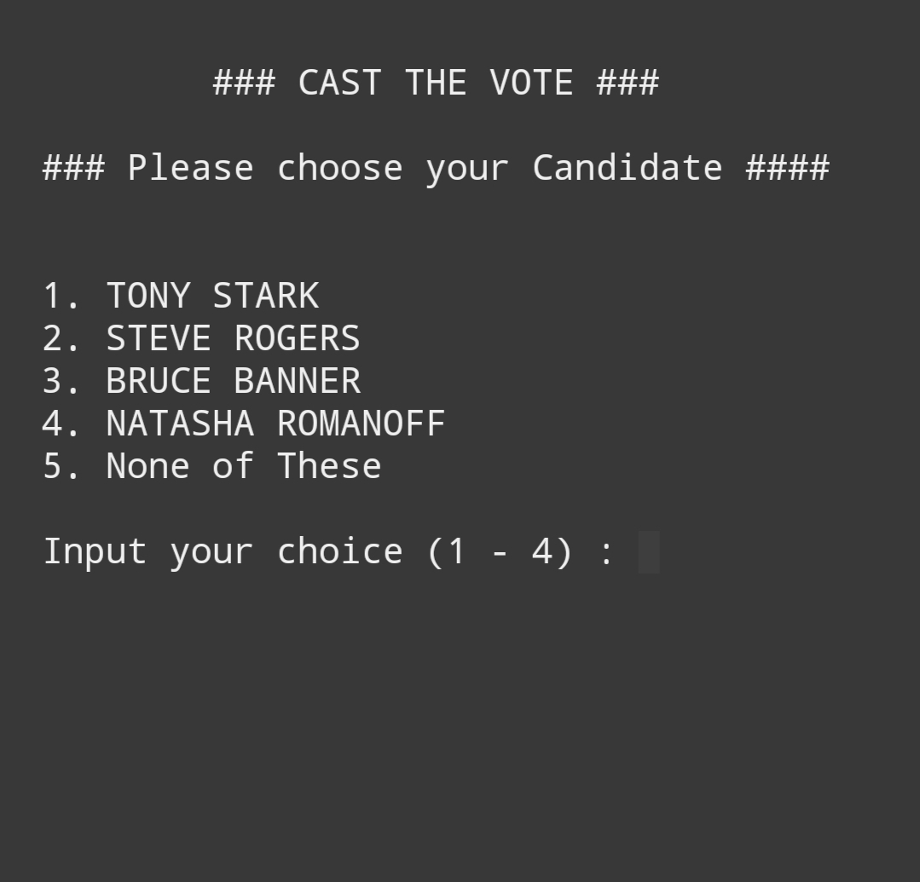
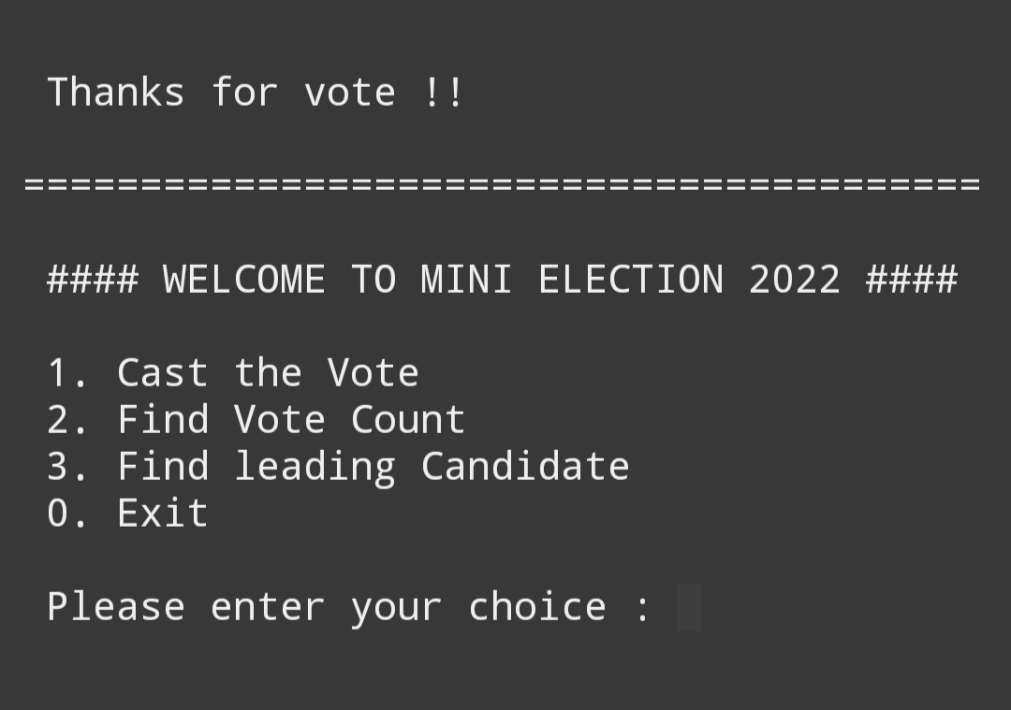

Slide 12
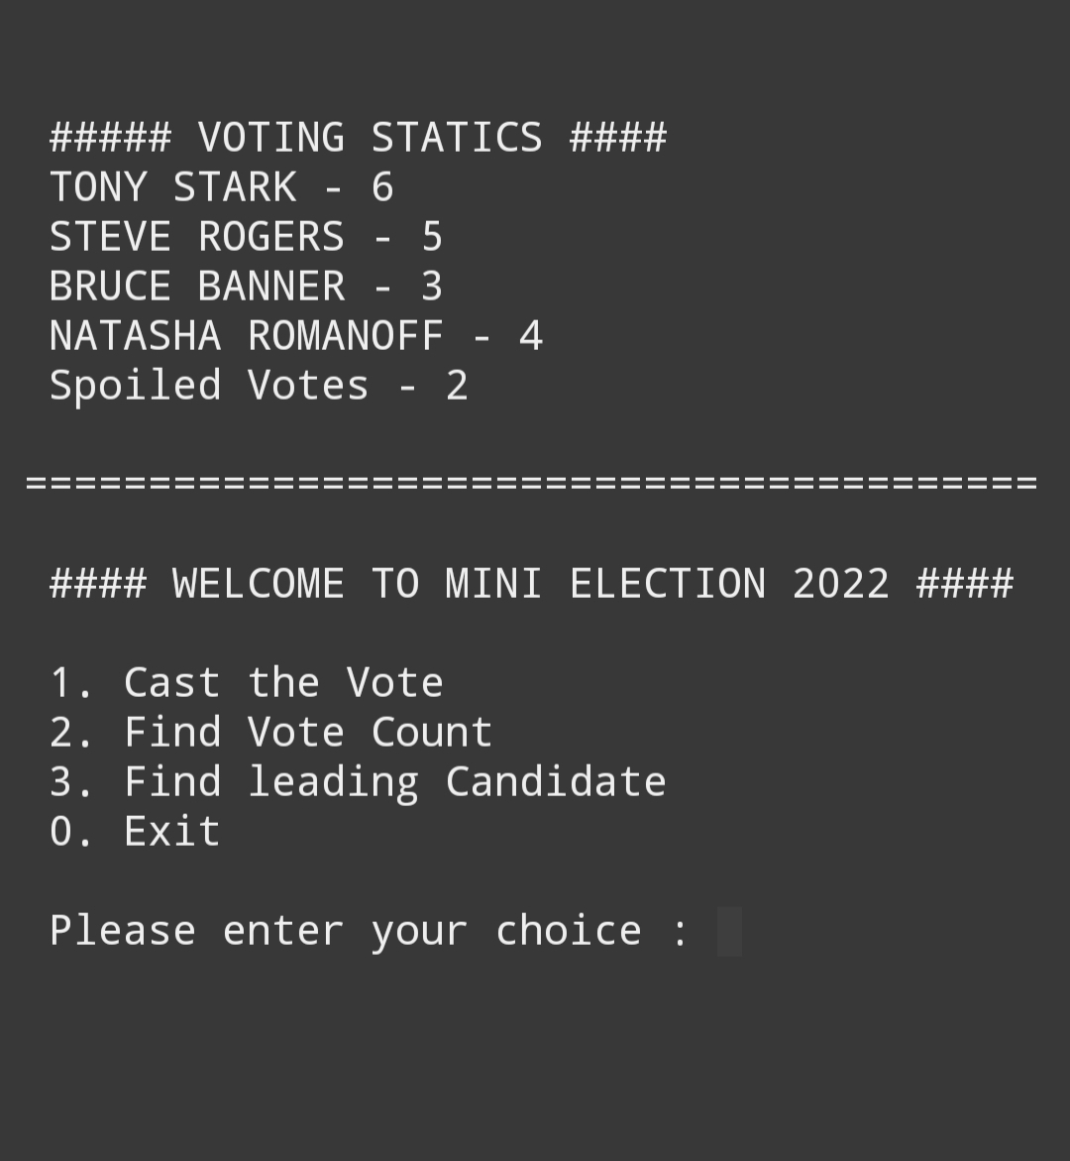

Slide 13
